Slide 1
Centralized Admin Management With Role Based Access
Batch Number:08
D. V Sai Ganesh(213C1A0509)
M. Radha Krishna(213C1A0521)
K. Jeevana Rekha(213C1A0519)
Project guide :-
Smt. N. SUSHMA
Assoc . Prof,CSE

Slide 2
ABSTRACT :-
Centralized Admin Management refers to a single control point for managing user access and security policies across an organization . RBCA assigns access rights to users based on their job roles rather than individual identities . It ensures consistency in permissions, reducing administrative overhead and human error . Access policies are enforced through a central system, making security management more efficient . Permissions can be easily updated by modifying role definitions rather than individual accounts.

Slide 3
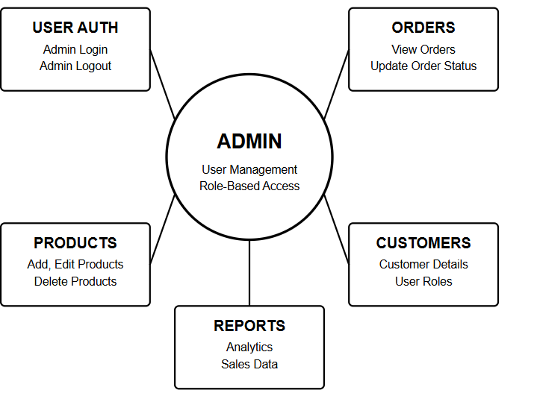
SOFTWARE REQUIREMENT ANALYSIS
FUNCTIONAL REQUIREMENTS :
User authentication (Admin login/logout)
Product management (Add, edit, delete products)
Order management (View, update order status)
User management (Customer details, roles)
Reports & analytics

Slide 4
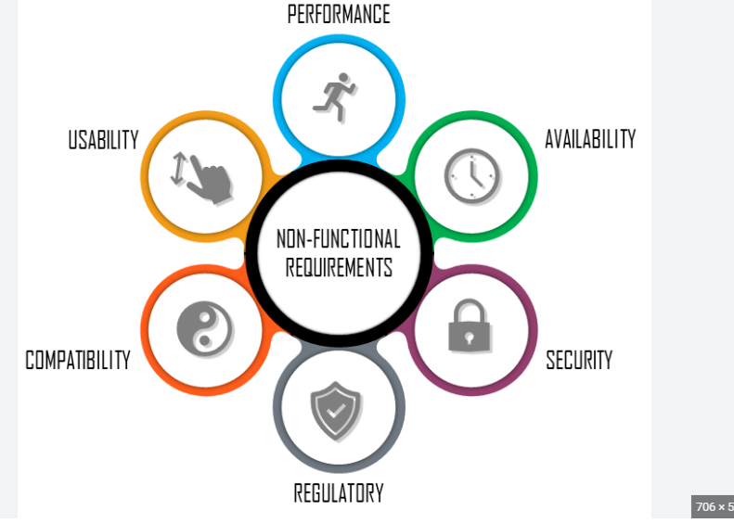
Non-Functional Requirements:
Performance – Pages should load quickly.
Security – Only admins can access the panel.
Scalability – The system should support many users.
Usability – The interface should be simple and user-friendly.
Reliability – The system should work without issues.

Slide 5
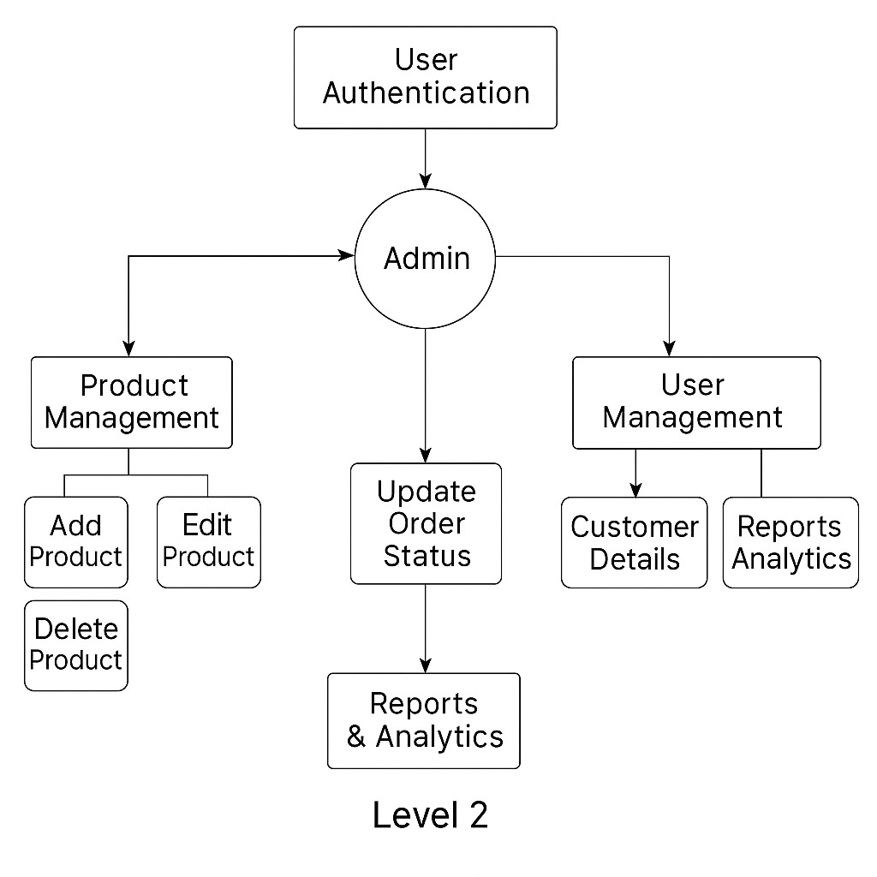
SOFTWARE DESIGN
DATA FLOW DIAGRAMS:-

Slide 6
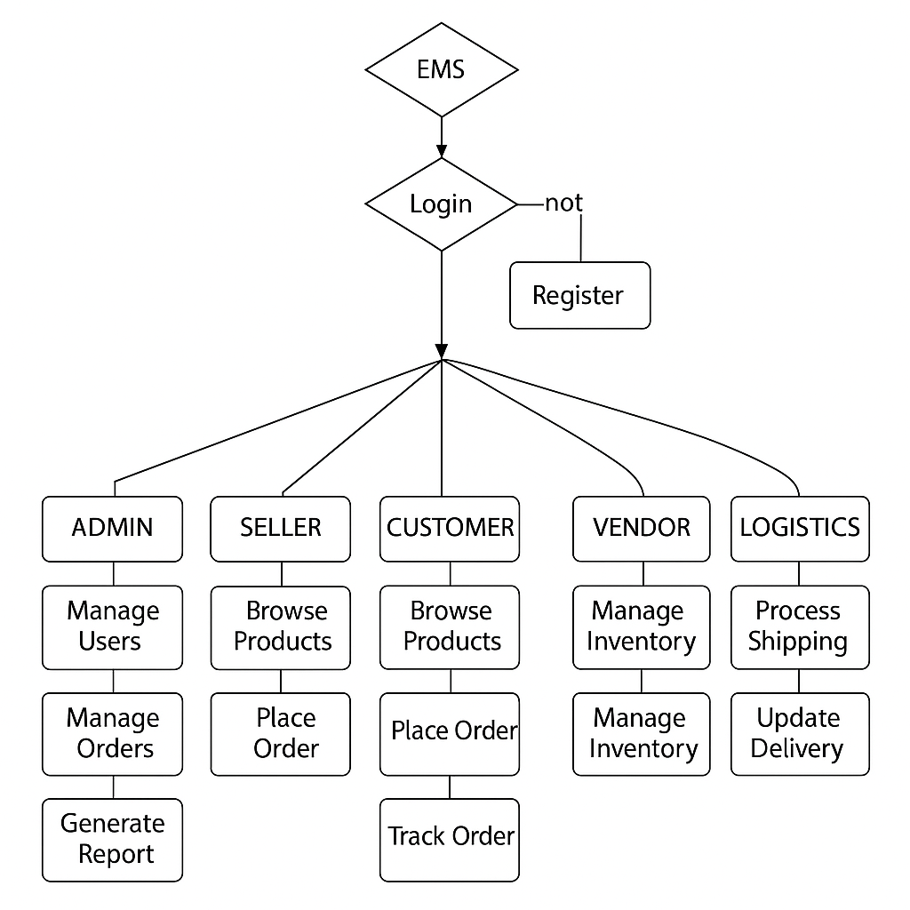
CONTROL FLOW DIAGRAM:-

Slide 7
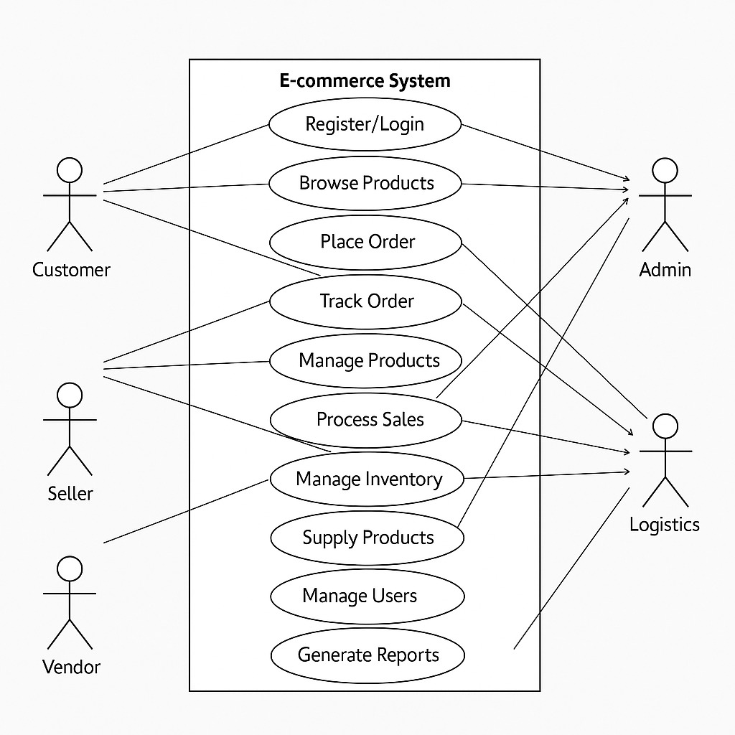
UML DIAGRAMS:-

Slide 8
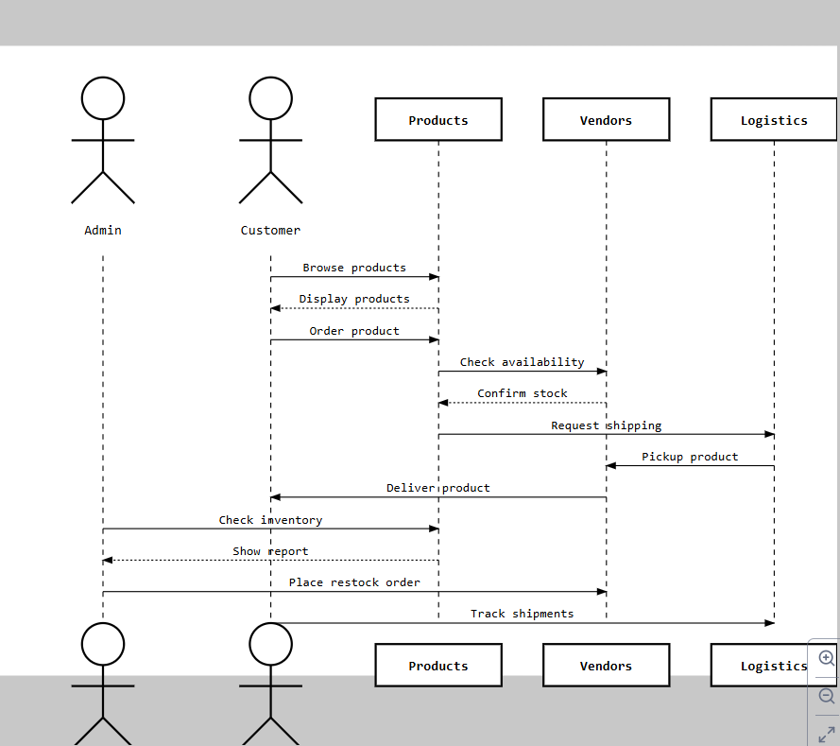
SEQUENCE DIAGRAM

Slide 9
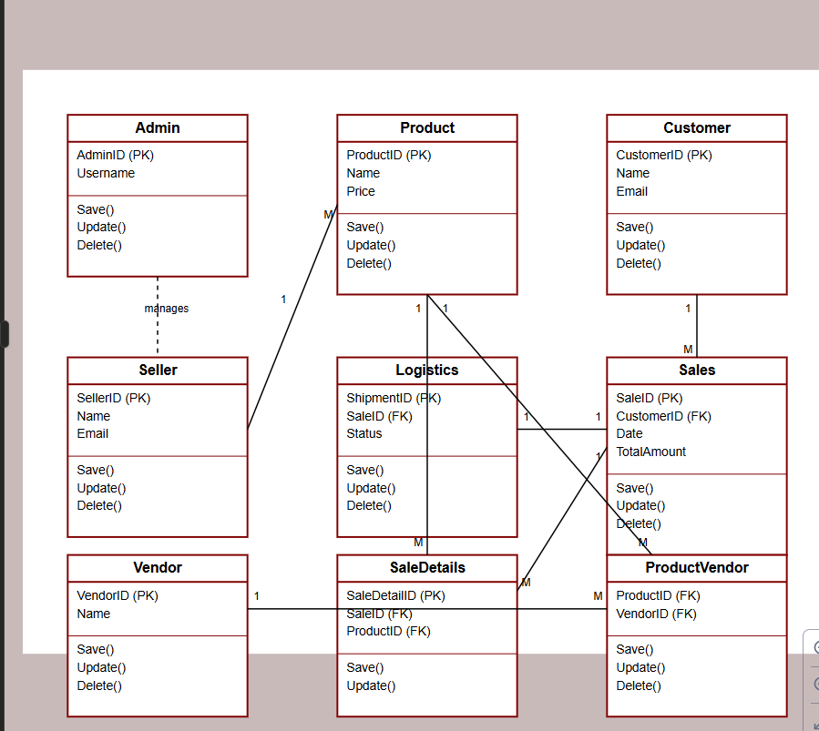
DATABASE DIAGRAM:-

Slide 10
THANK YOU

